Slide 1
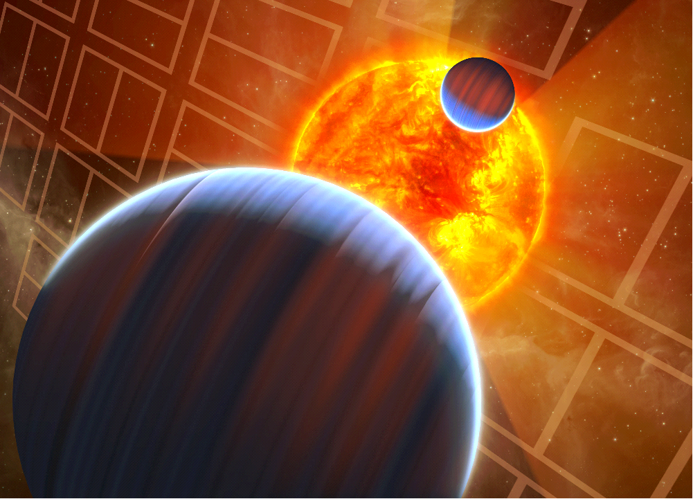
Exploring Distant Worlds with
NASA’s Kepler Mission
Jason H. Steffen
Northwestern University
Clark Planetarium
August 15, 2013

Slide 2
August 15, 2013
“NASA Ends Attempts to Fully Recover
Kepler Spacecraft,
Potential New Missions Considered”
Science from Kepler will continue for a very long time.
Results presented here use less than half of the Kepler data.

Slide 3
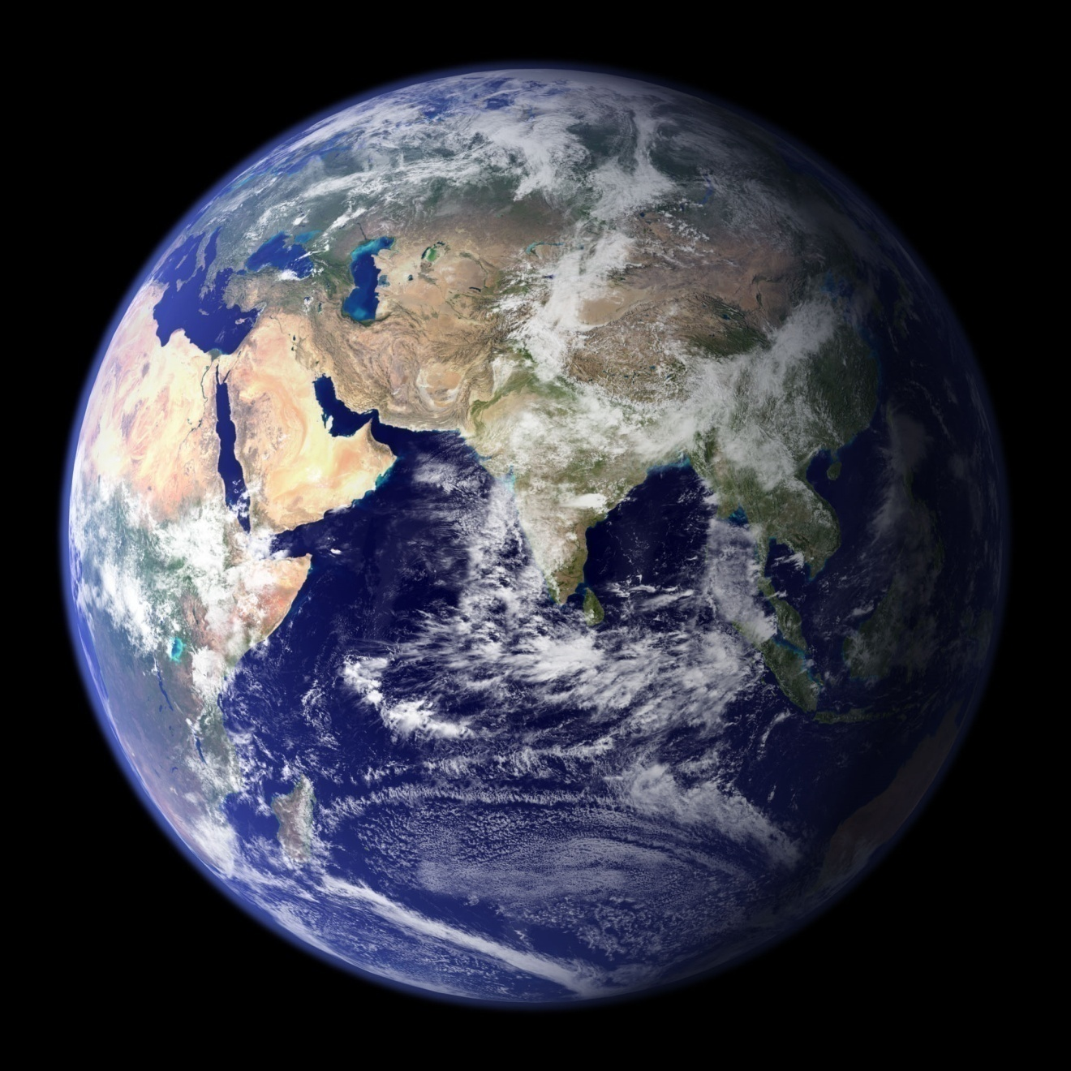
Kepler Motivation

Slide 4
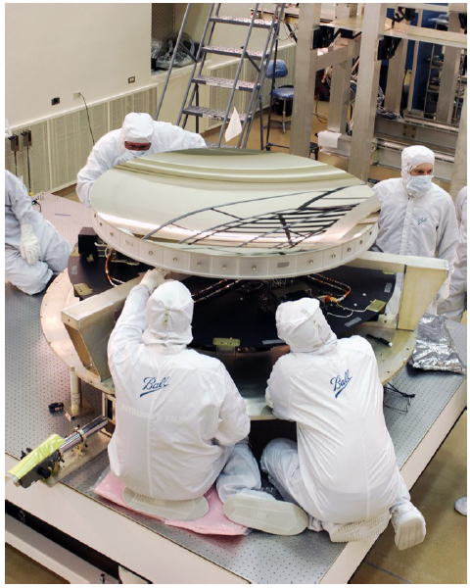
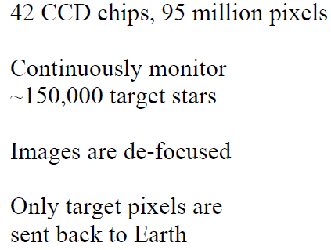
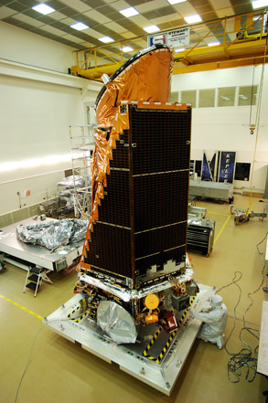
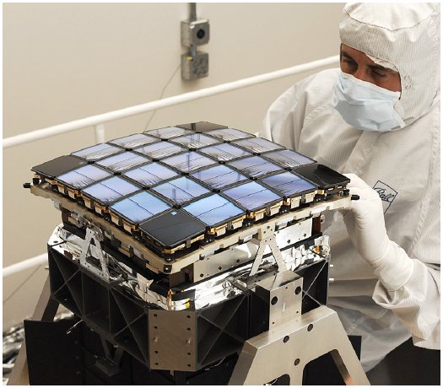
Kepler Spacecraft
50 micromagnitudes in 6 hours
30 minute cadence

Slide 5
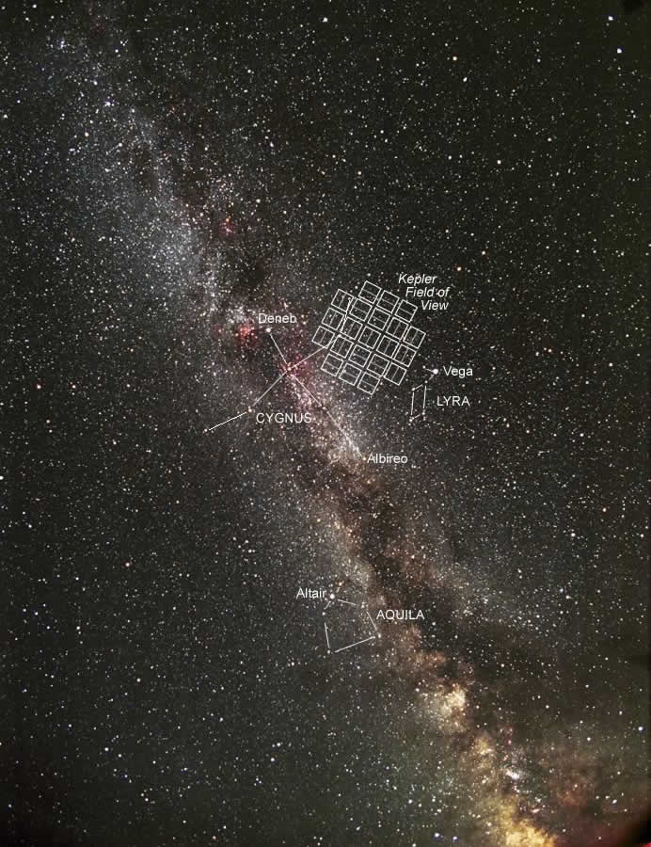
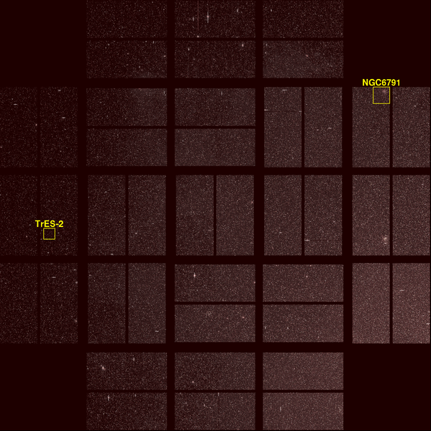
Kepler’s view of the Sky

Slide 6
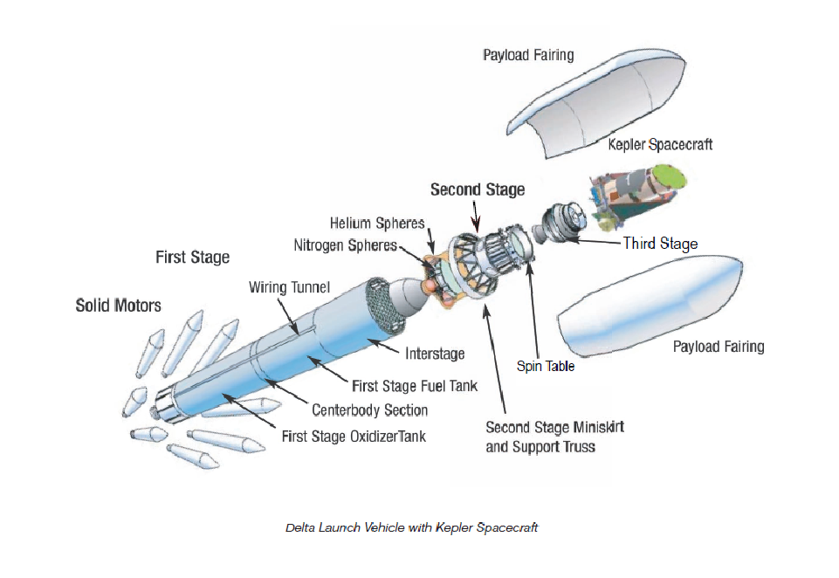
Launch Vehicle

Slide 7
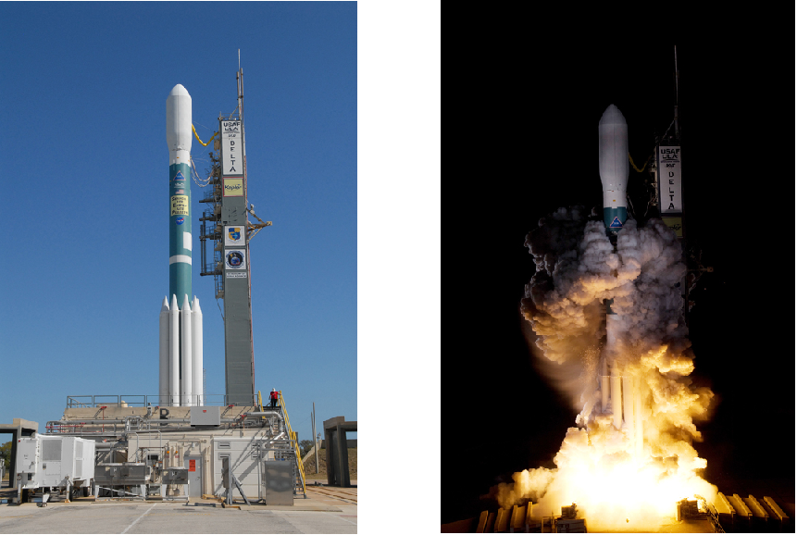
Kepler Launch March 2009

Slide 8
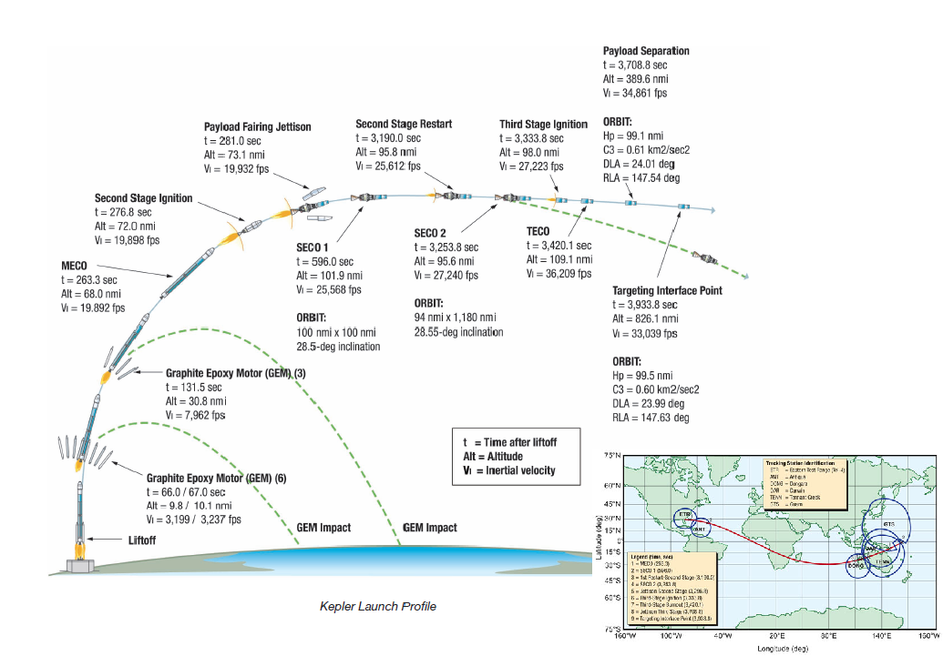
Kepler Launch March 2009

Slide 9
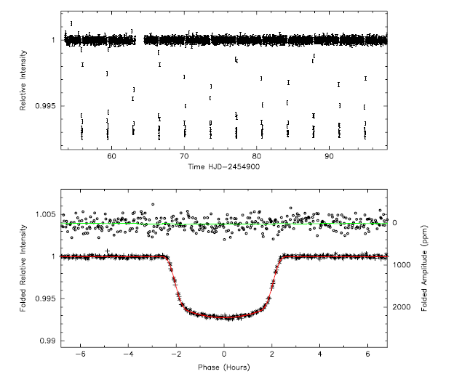
Planet Finding Method
Planetary Transits

Slide 10
Planet Finding Method
Planetary Transits
Jupiter: 1 part per 1000
Earth: 1 part per 100,000

Slide 11
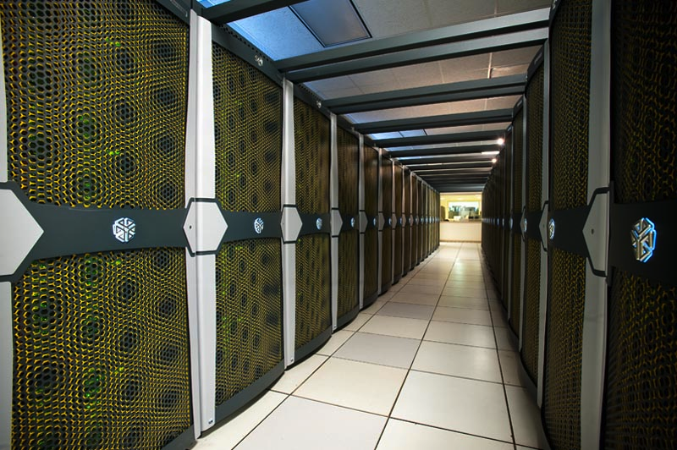
Kepler Data Processing

Slide 12
Kepler Data Quality

Slide 13
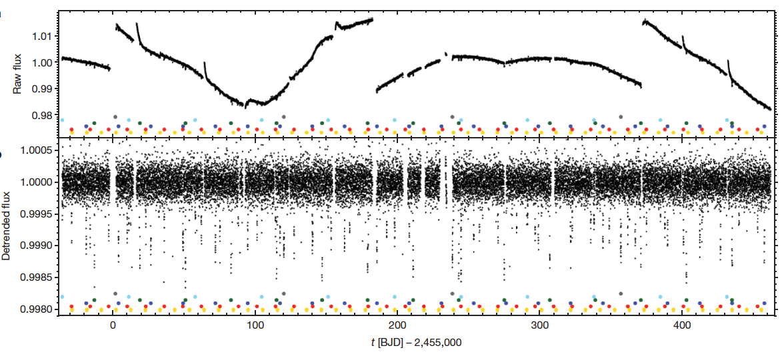
Kepler Data

Slide 14
Kepler Data

Slide 15
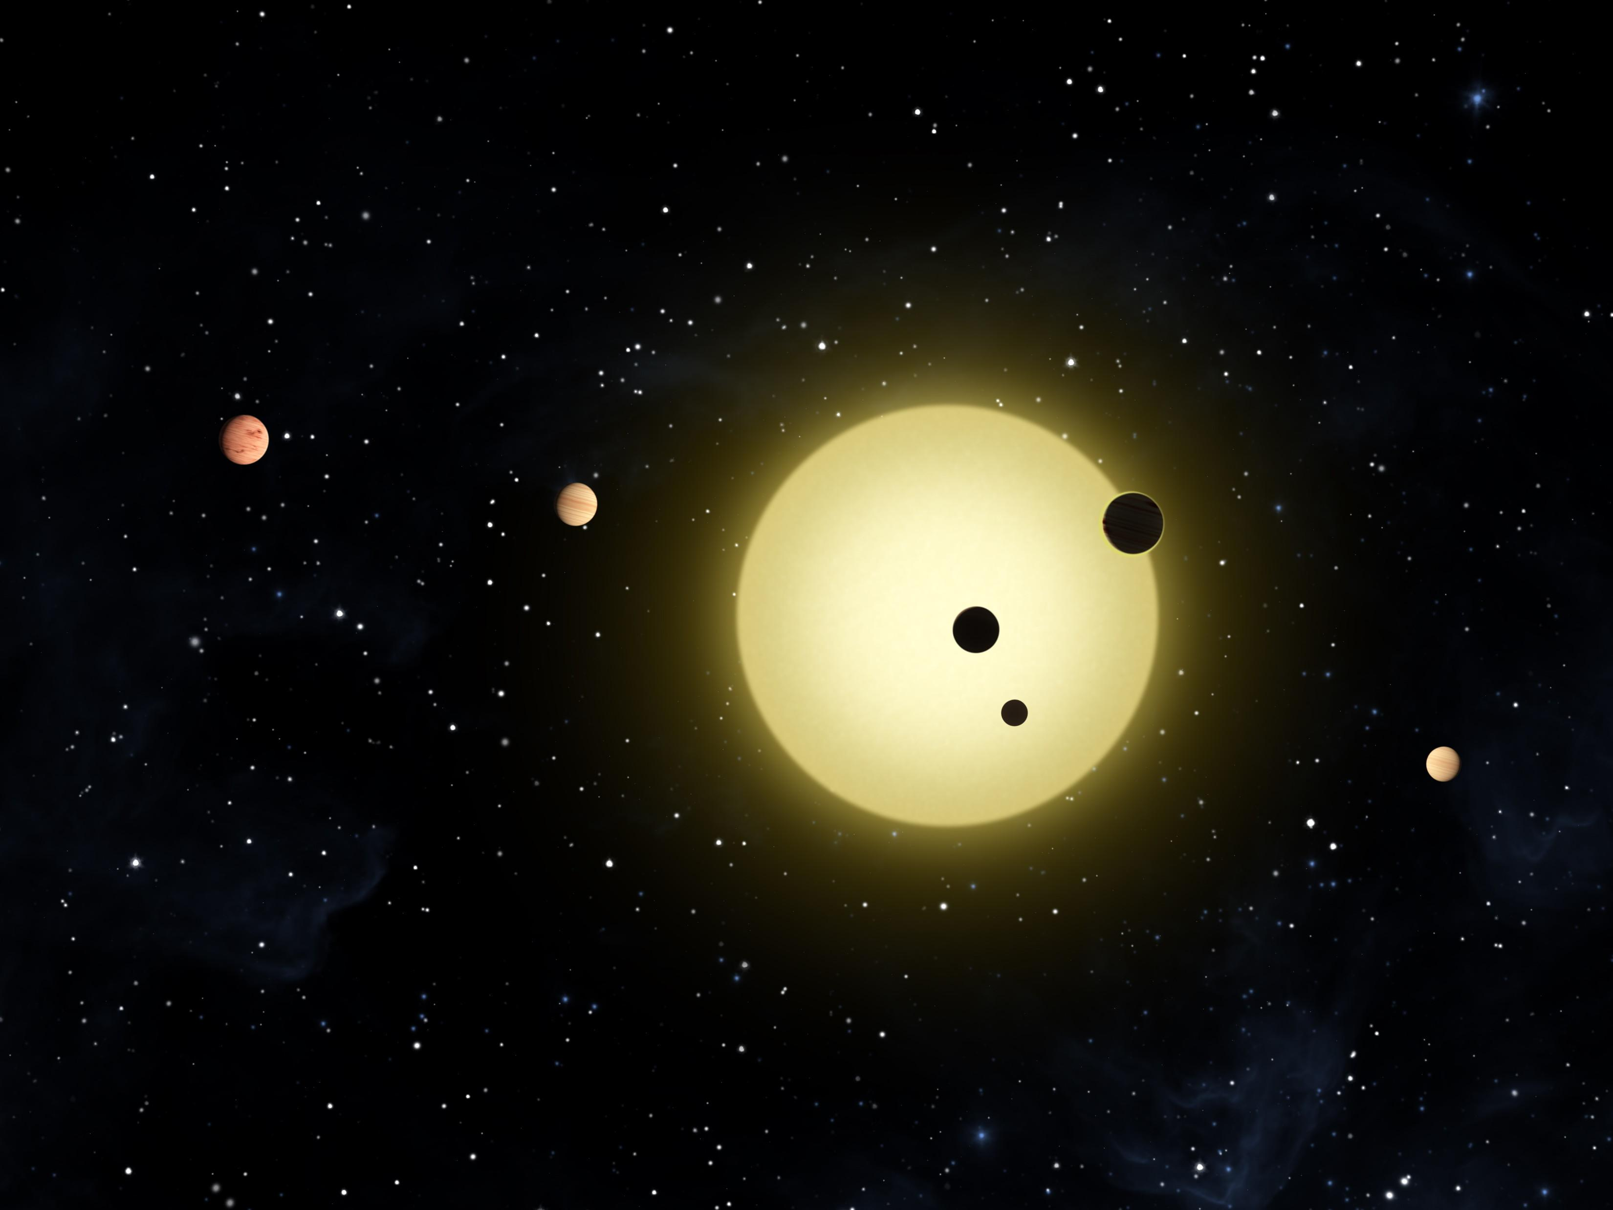
Kepler 11 System

Slide 16
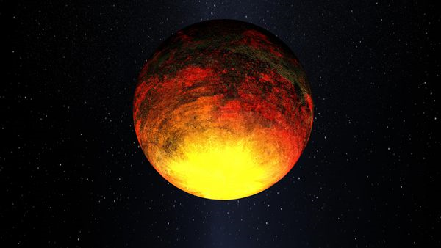
Kepler’s Gems: Kepler 10

Slide 17
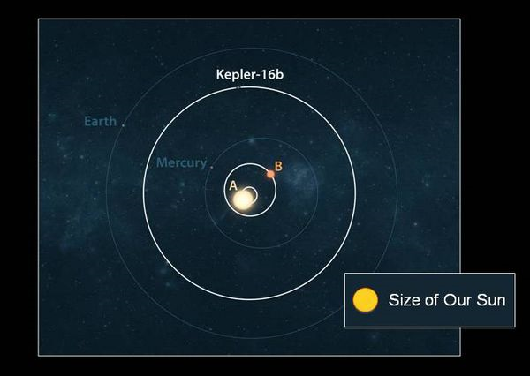
Kepler’s Gems: Kepler 16

Slide 18
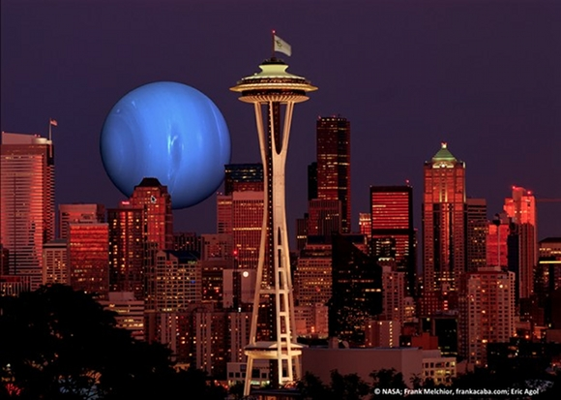
Kepler’s Gems: Kepler 36

Slide 19
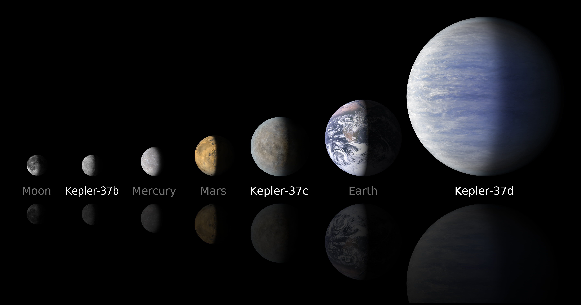
Kepler’s Gems: Kepler 37

Slide 20
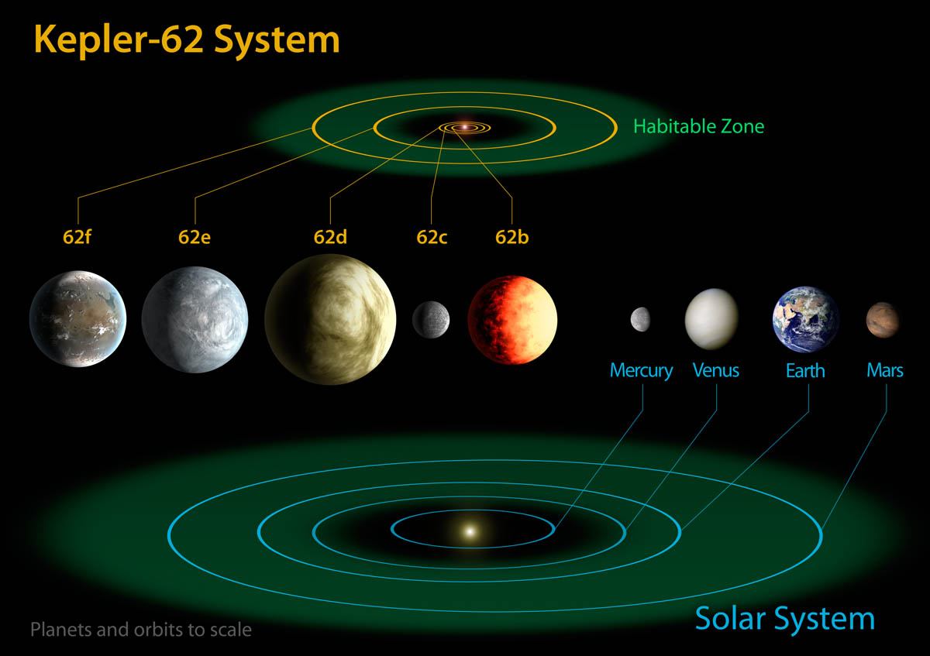
Kepler’s Gems: Kepler 62

Slide 21
Planet Candidate
vs.
Planet

Slide 22
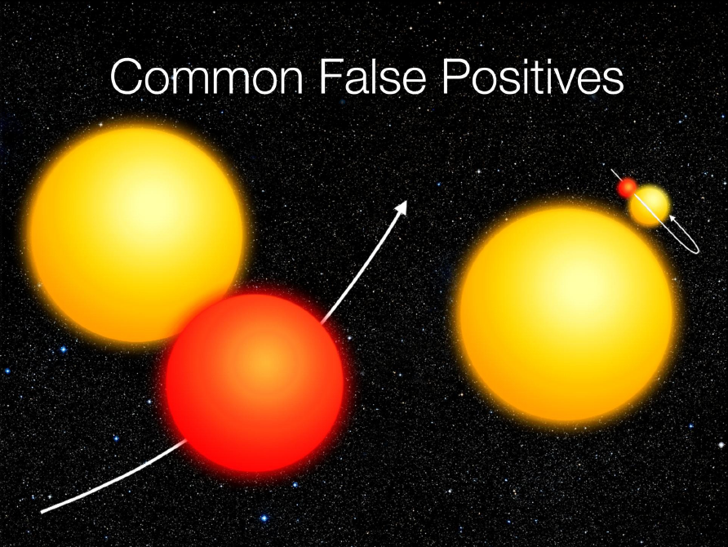

Slide 23
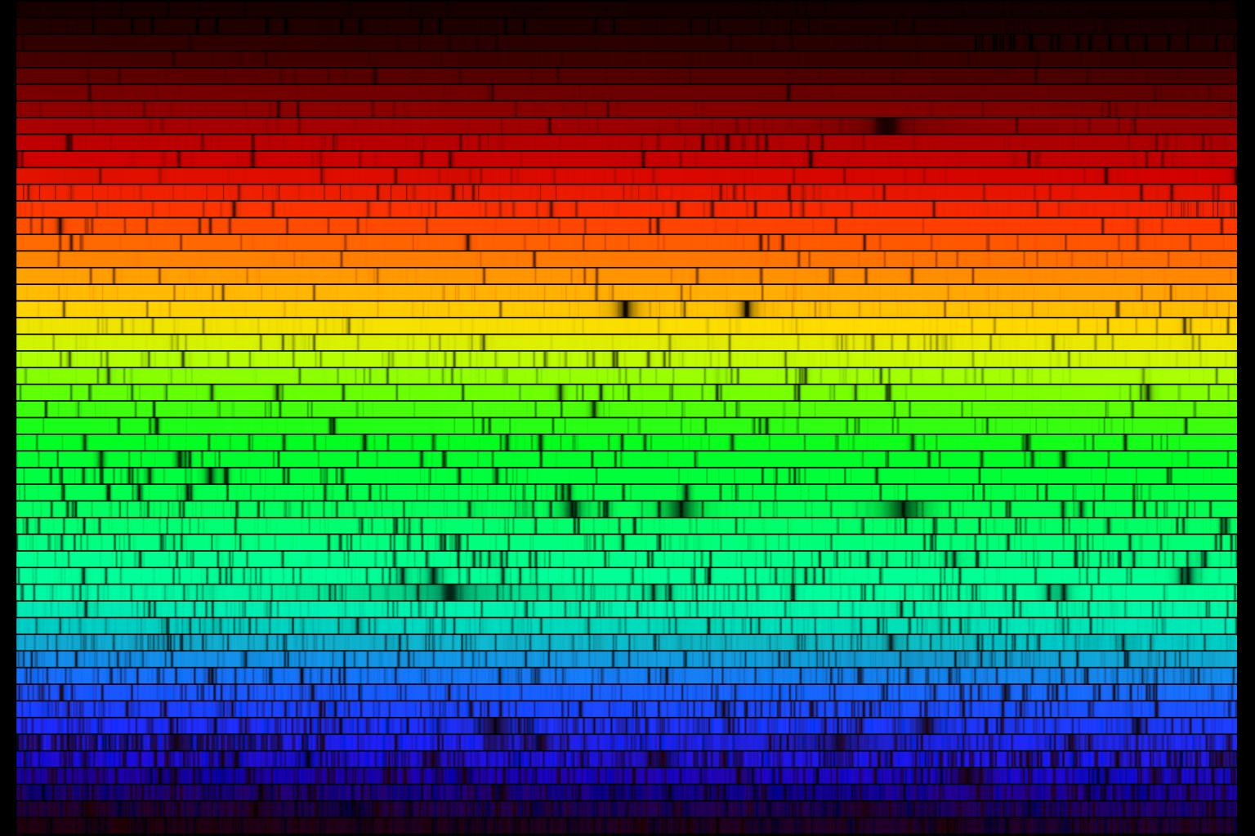
Solar Spectrum

Slide 24
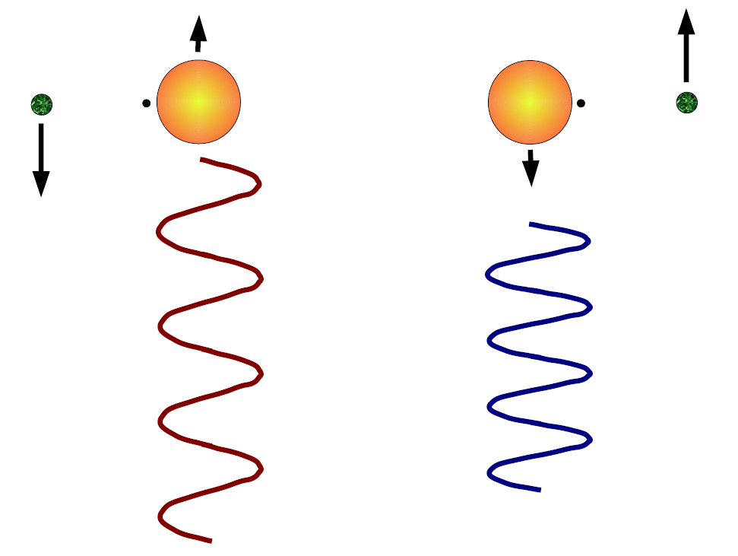
From Candidate to Planet
Doppler Shift Measurements

Slide 25
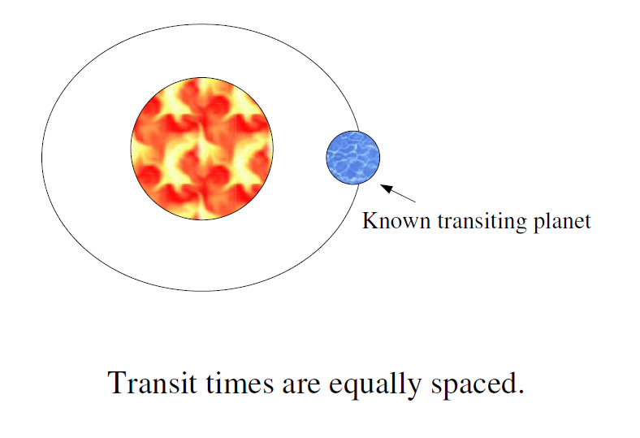
From Candidate to Planet
Transit Timing Variations
Agol, Steffen, Sari, Clarkson (2005), Holman and Murray (2005)

Slide 26
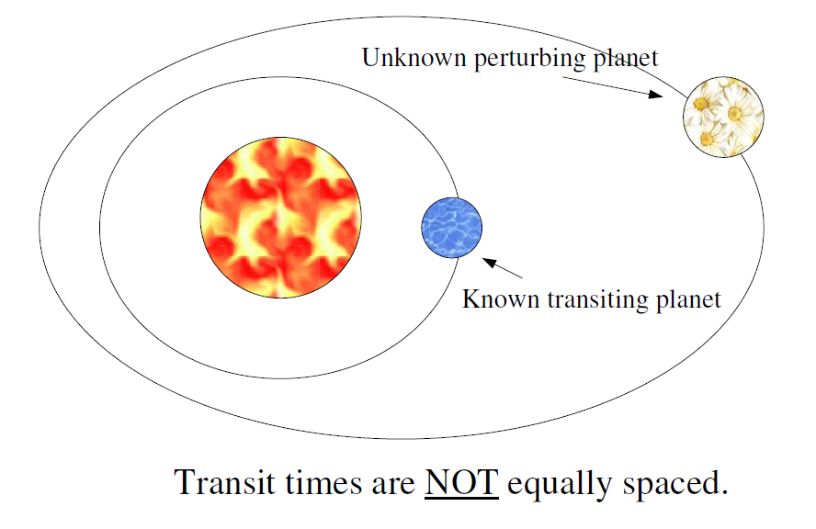
From Candidate to Planet
Transit Timing Variations
Agol, Steffen, Sari, Clarkson (2005), Holman and Murray (2005)

Slide 27
Transit Timing Variations
Deviation from a constant orbital period
15 Minutes
Time

Slide 28
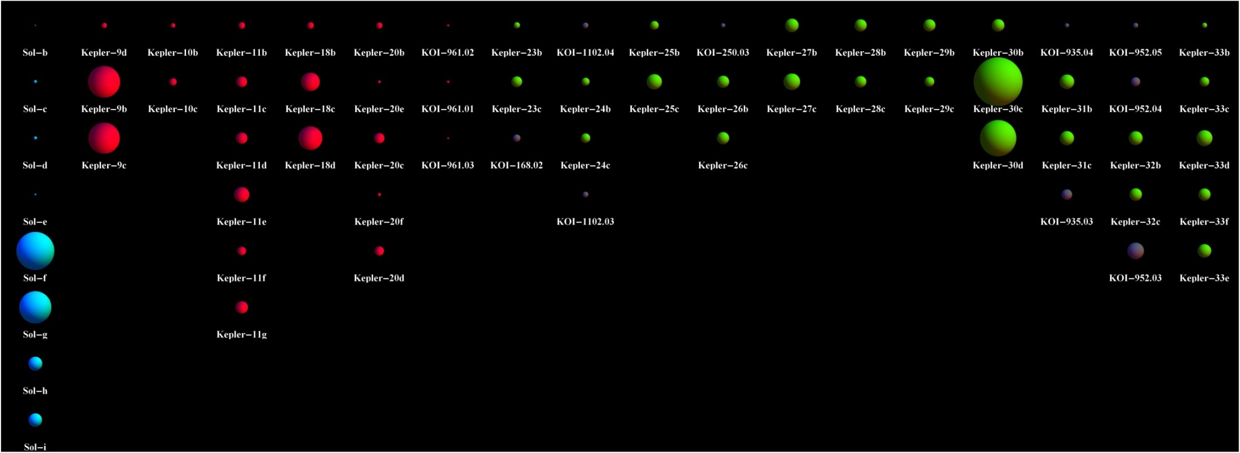
Kepler 23, 24, 25, 26, 27, 28, 29, 30, 31, 32, 33
Blue: Solar System
Red: Known planets in multi-transiting systems
Gray: KOIs in multi-transiting systems
Green: Newly confirmed planets
Ford et al. (2012a), Fabrycky et al. (2012a), Steffen et al. (2012a), Lissauer et al. (2012)

Slide 29
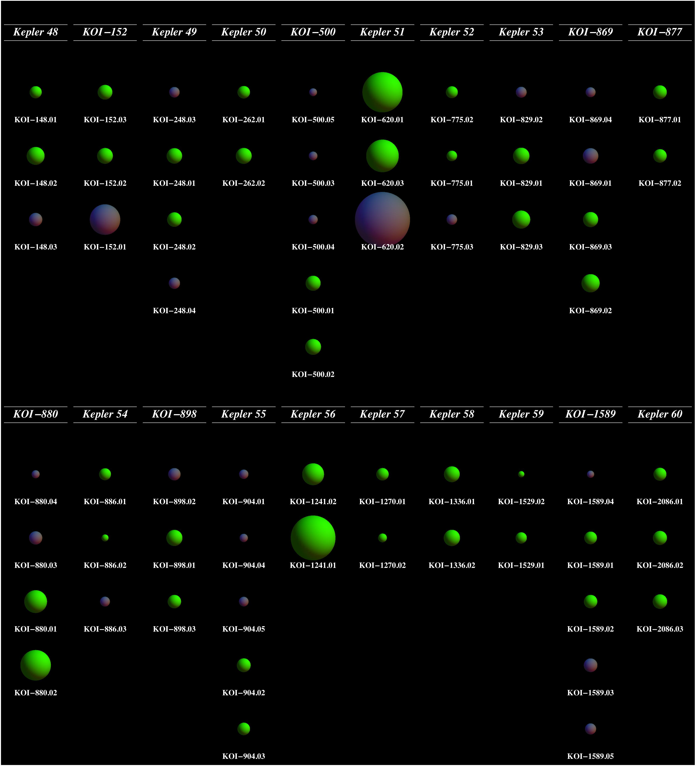
Kepler 48 — Kepler 60 (and a few others)
TTVs have confirmed
most of the Kepler
exoplanet systems.
Steffen et al. (2012e)
Xie (2012)

Slide 30
Mass-Radius Relationship
Lissauer et al. 2013

Slide 31
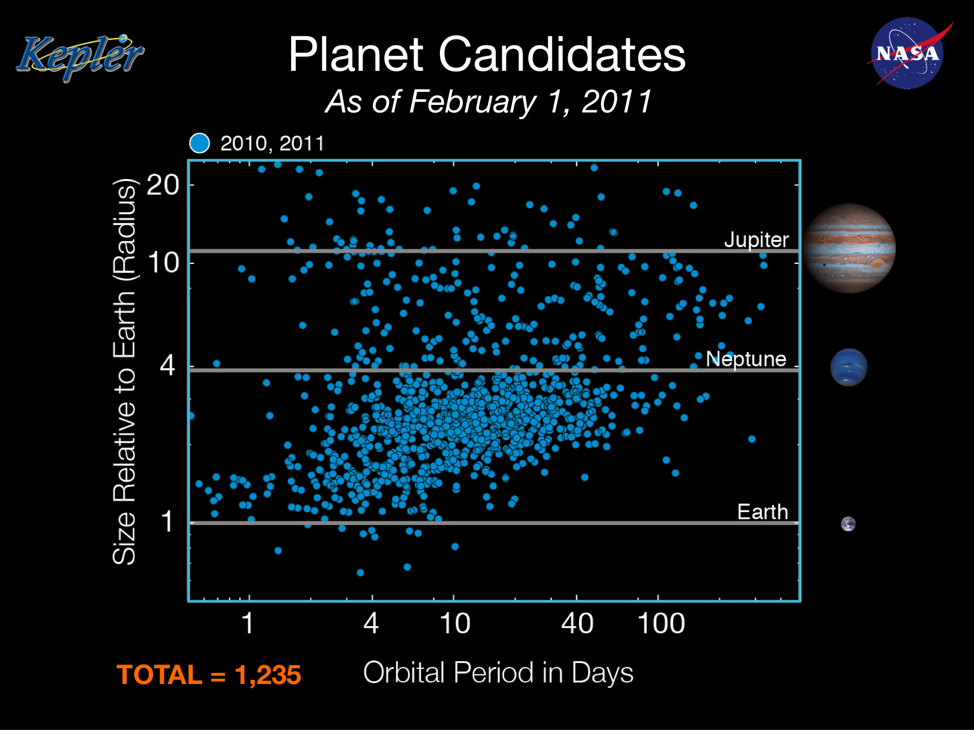

Slide 32
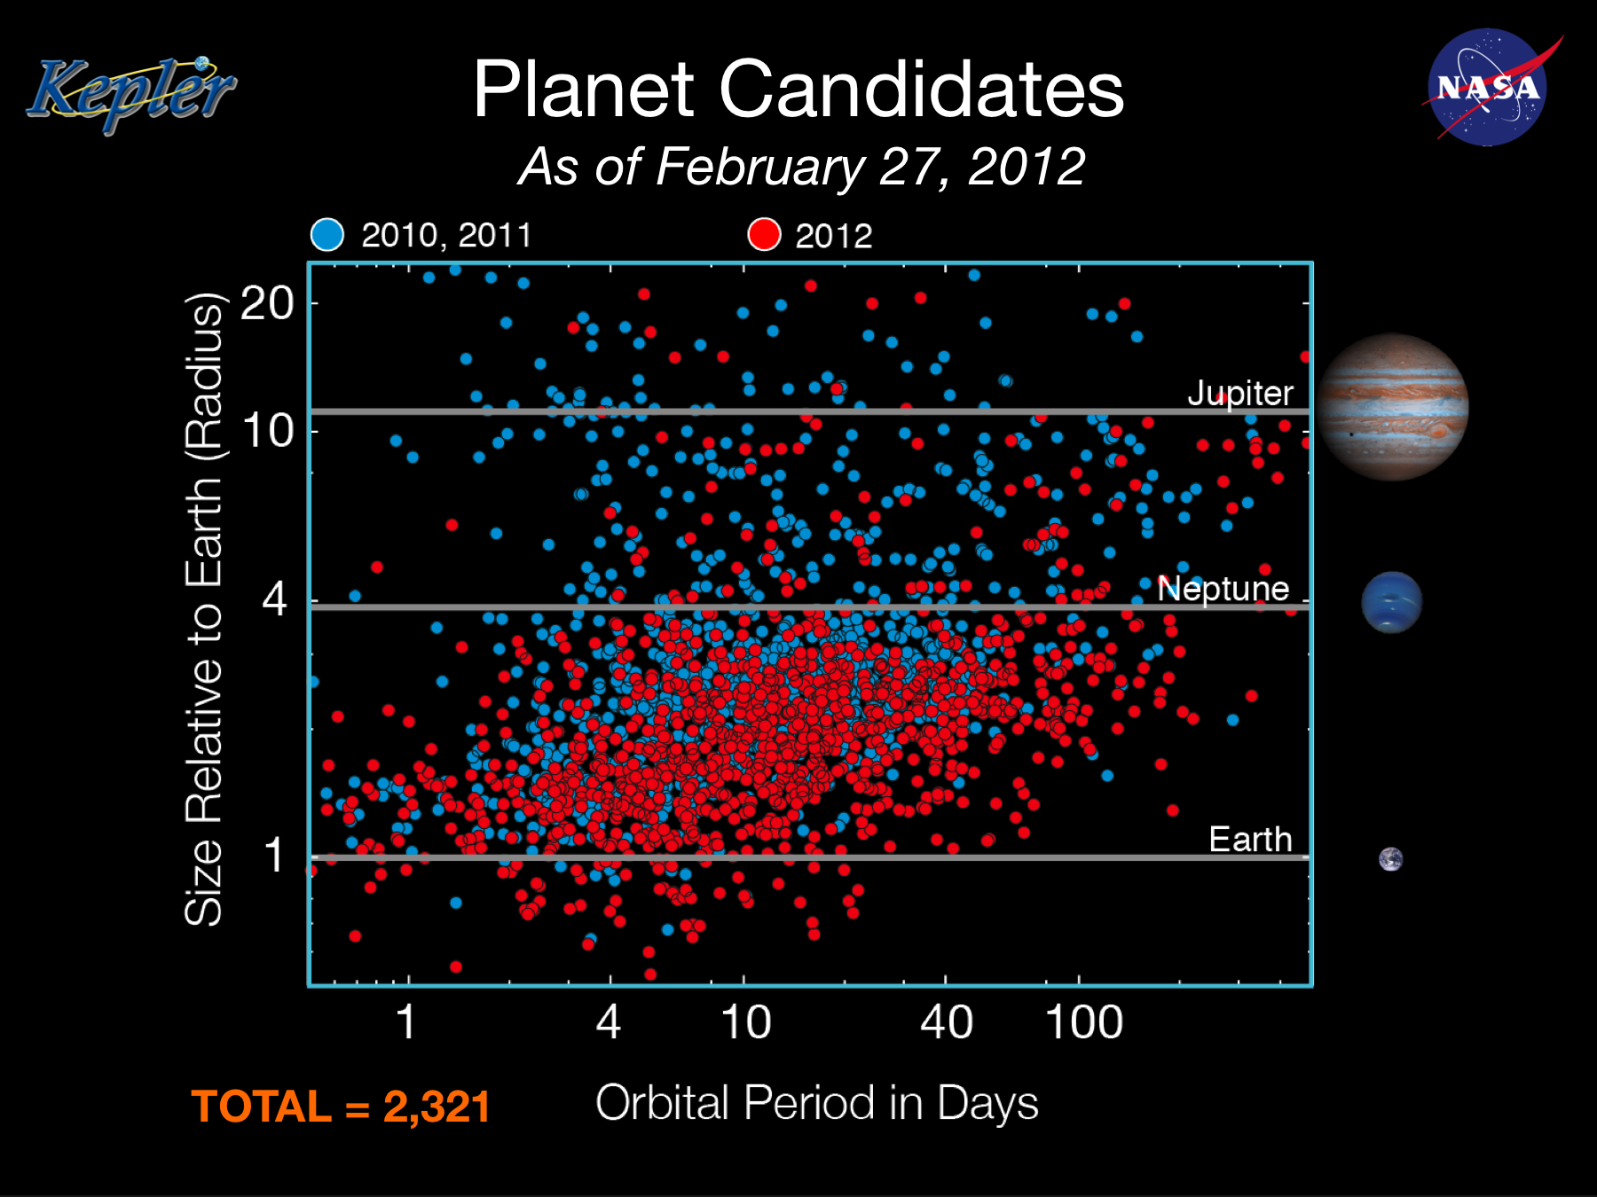

Slide 33
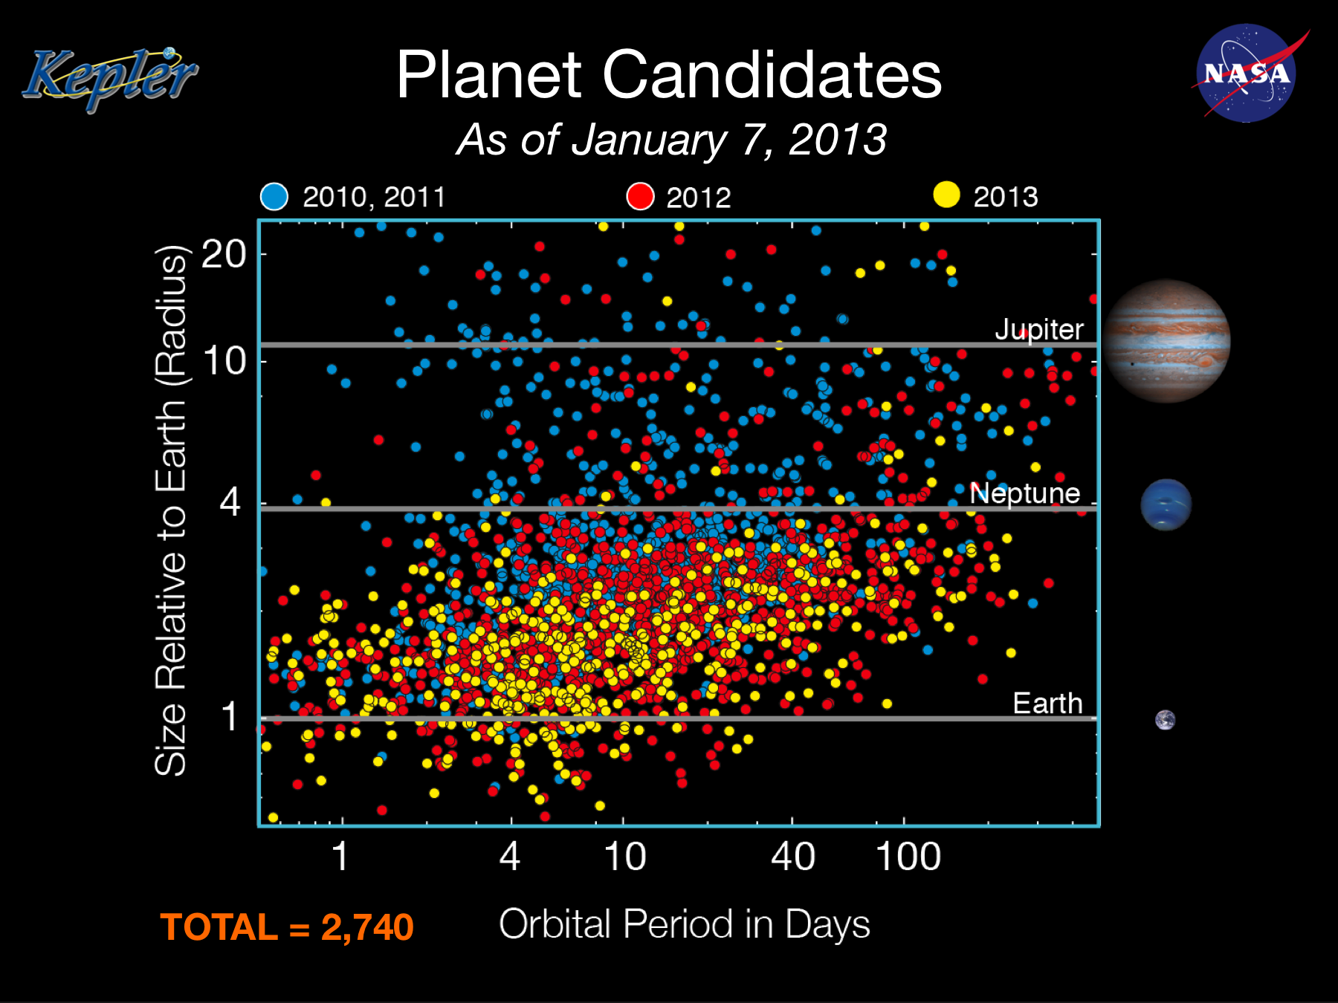

Slide 35
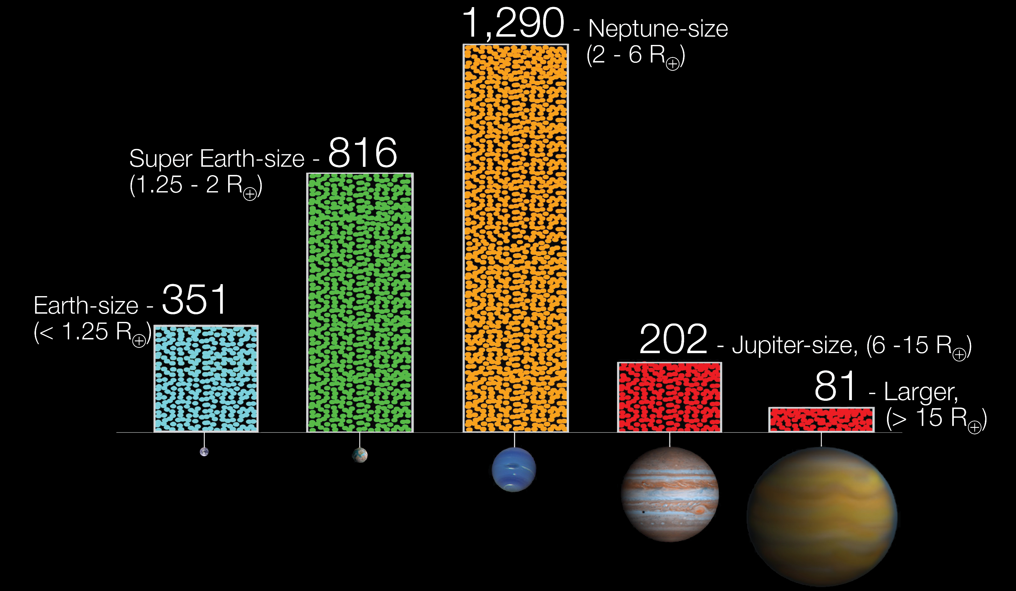
2,740 Planet Candidates
As of January 2013

Slide 36
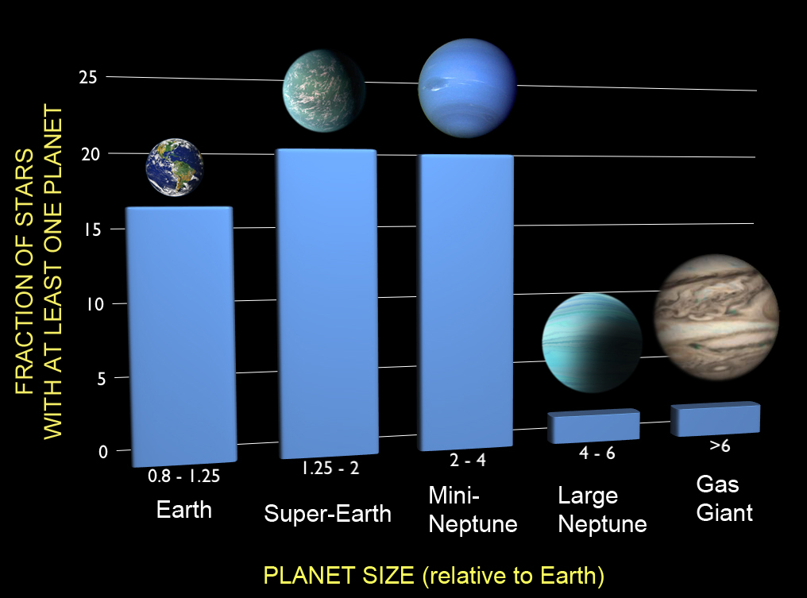
Planet Occurrence Rates

Slide 37
Planet Occurrence Rates
Over 2/3
of stars
have planets!

Slide 38
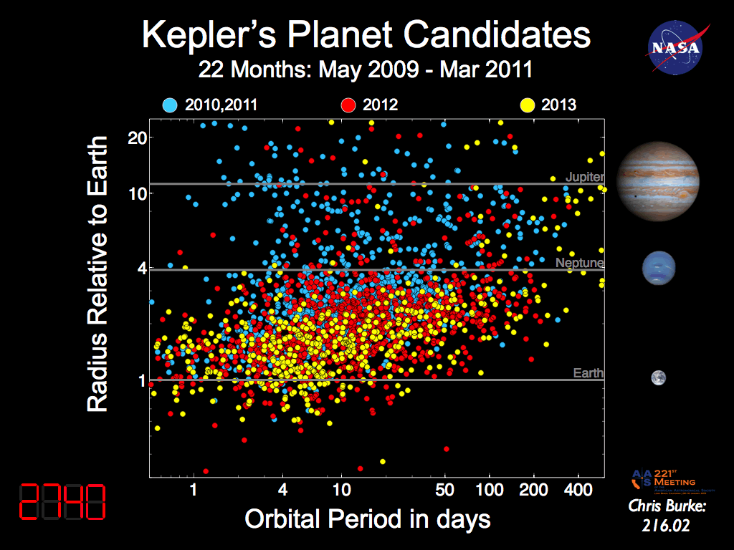

Slide 39
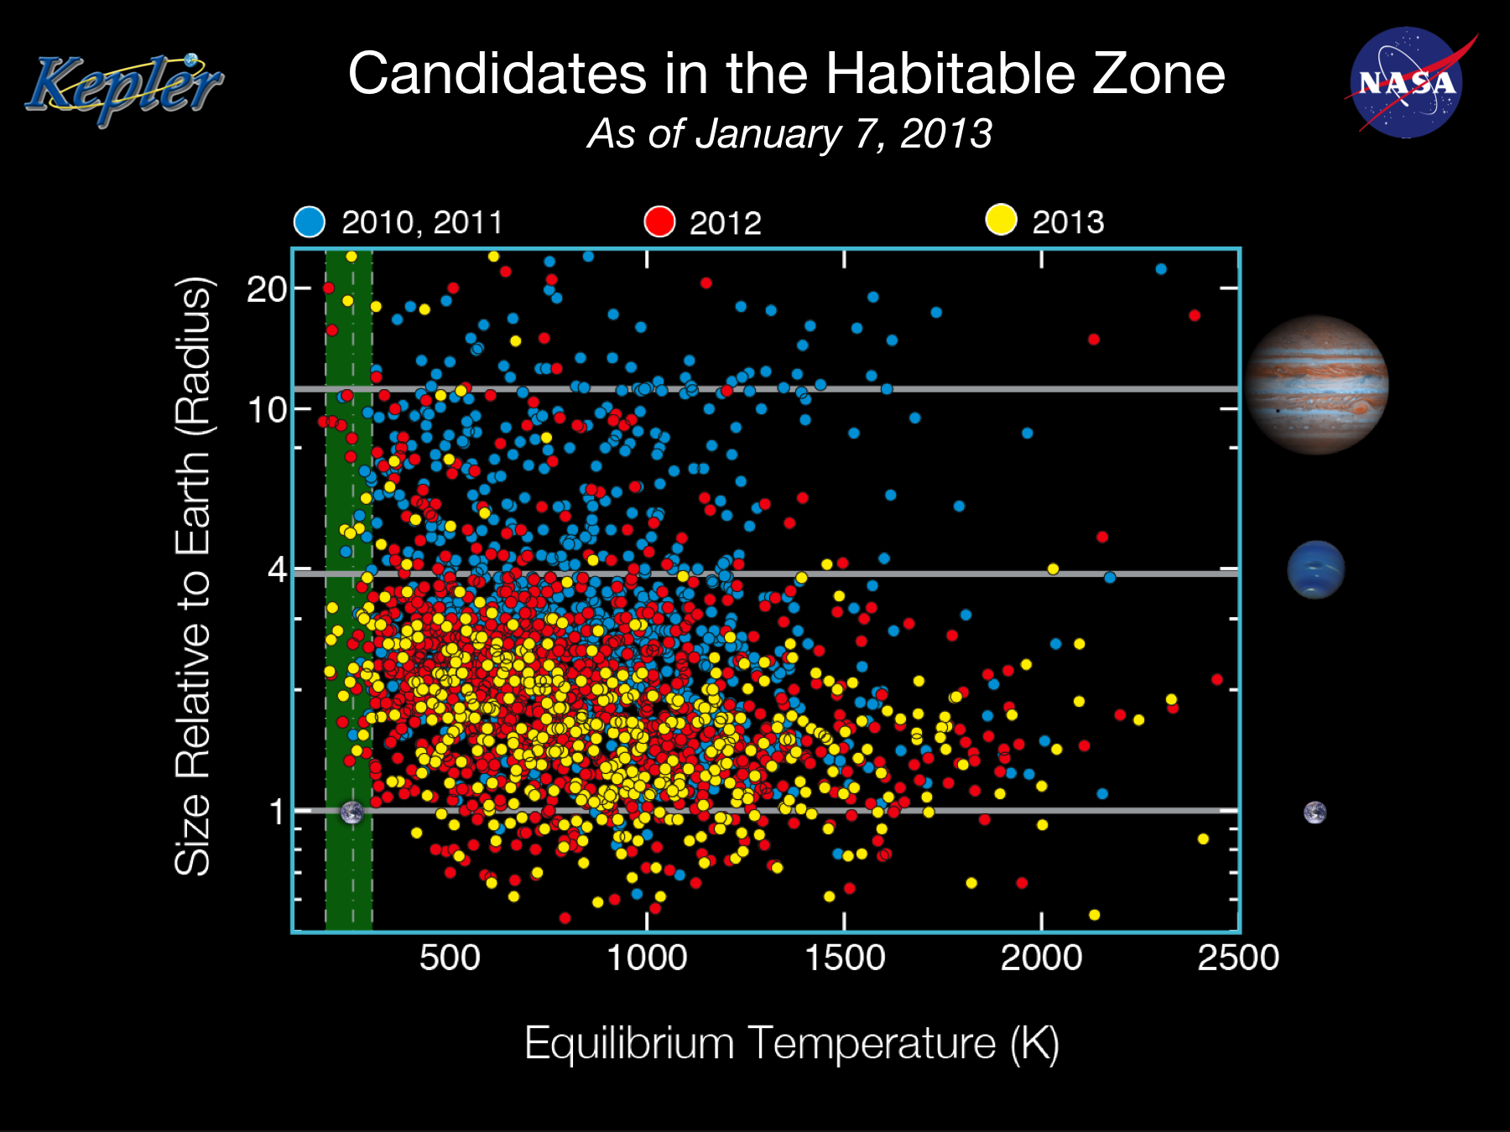

Slide 40
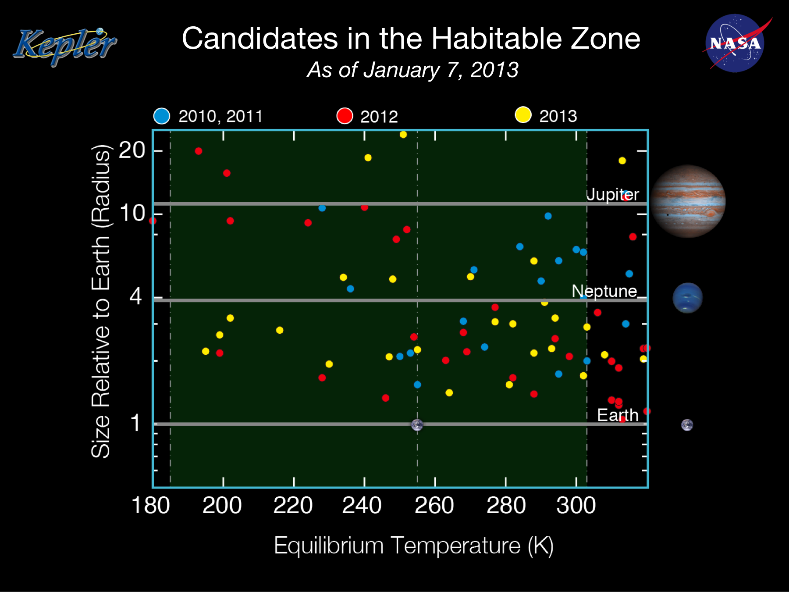

Slide 41
What else can we learn
from Kepler?

Slide 43
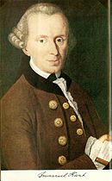
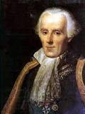
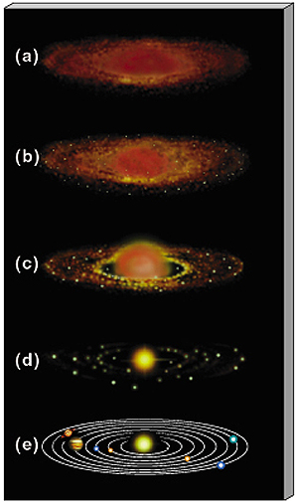
Theory of Planet Formation
Kant
Laplace
Aside from time-varying support
from scientists, nebular theory is
largely unchanged after more than
200 years – planets form from
a gaseous disk.

Slide 44
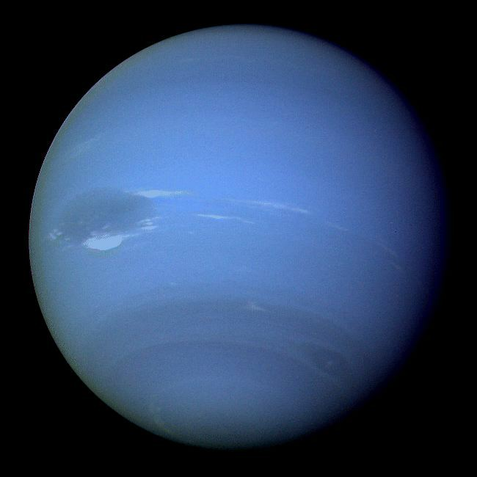
An anomaly from the solar system

Slide 45
An anomaly from the solar system
How did Neptune
get so big? It should
have run out of food.

Slide 46
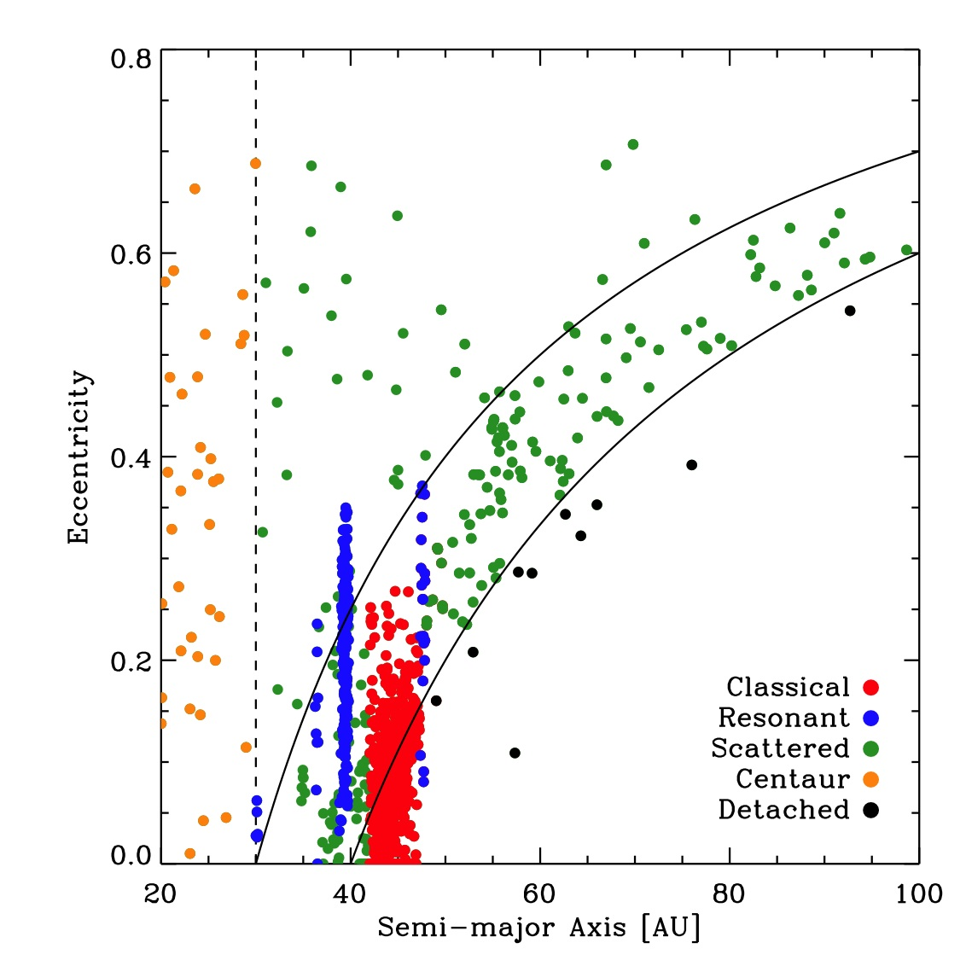
How to Explain Neptune
Comet-like objects beyond Neptune
Jewitt

Slide 47
How to Explain Neptune
Comet-like objects beyond Neptune
2:1
3:2
1:1
Jewitt

Slide 48
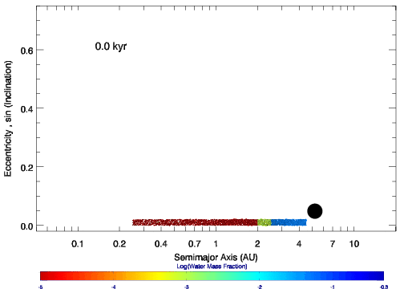
Resonances and Planet Migration
Mandell, Raymond & Sigurdsson (2007)

Slide 49
Kepler Multiplanet Systems
Period Ratio

Slide 50
Kepler Multiplanet Systems
These peaks are evidence for migration.
Period Ratio

Slide 51
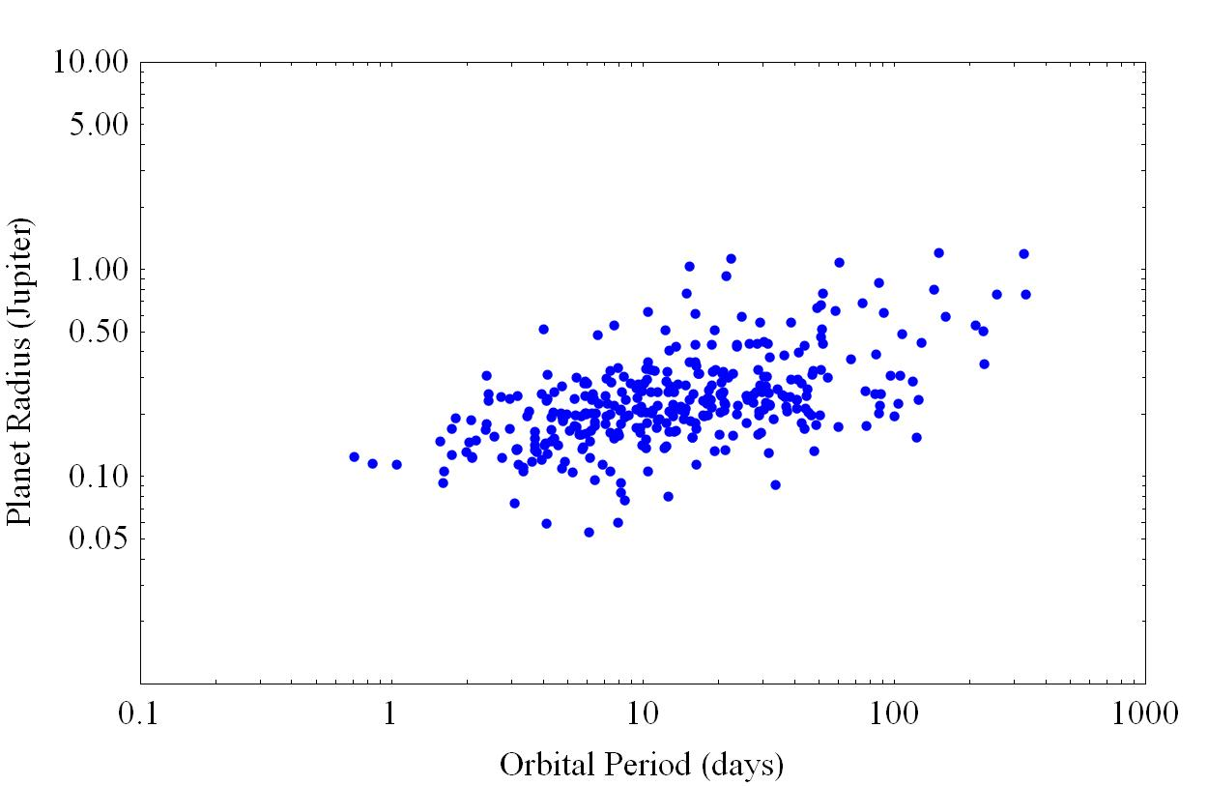
Different planet populations
Multiple Candidate Systems
Teff > 4600K only

Slide 52
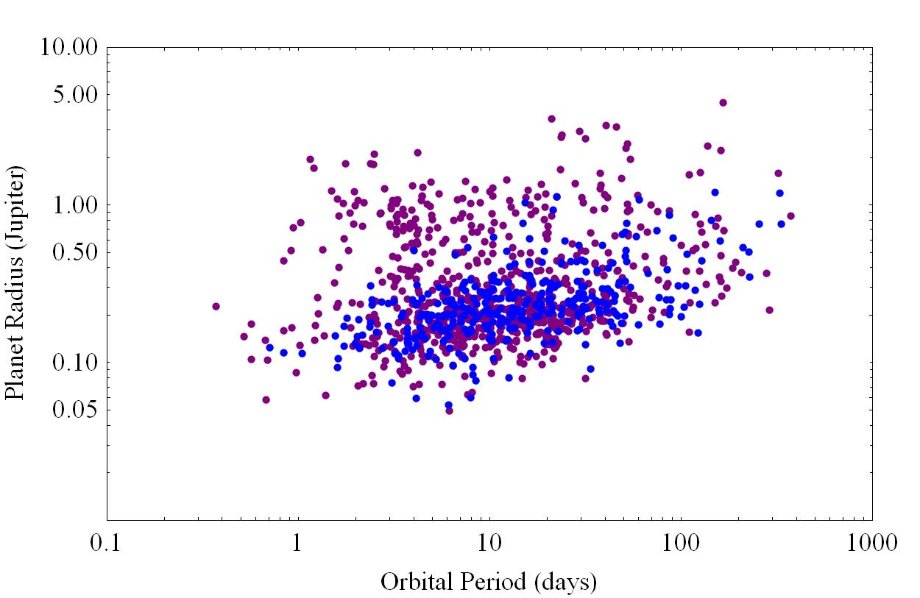
Different planet populations
Multiple Candidate Systems and Single Candidate Systems
Teff > 4600K only

Slide 53
Different planet populations
Multiple Candidate Systems and Single Candidate Systems
How do these planets get here?
Teff > 4600K only

Slide 54
The Migration of Hot Jupiters
Steffen et al. (2012b)

Slide 55
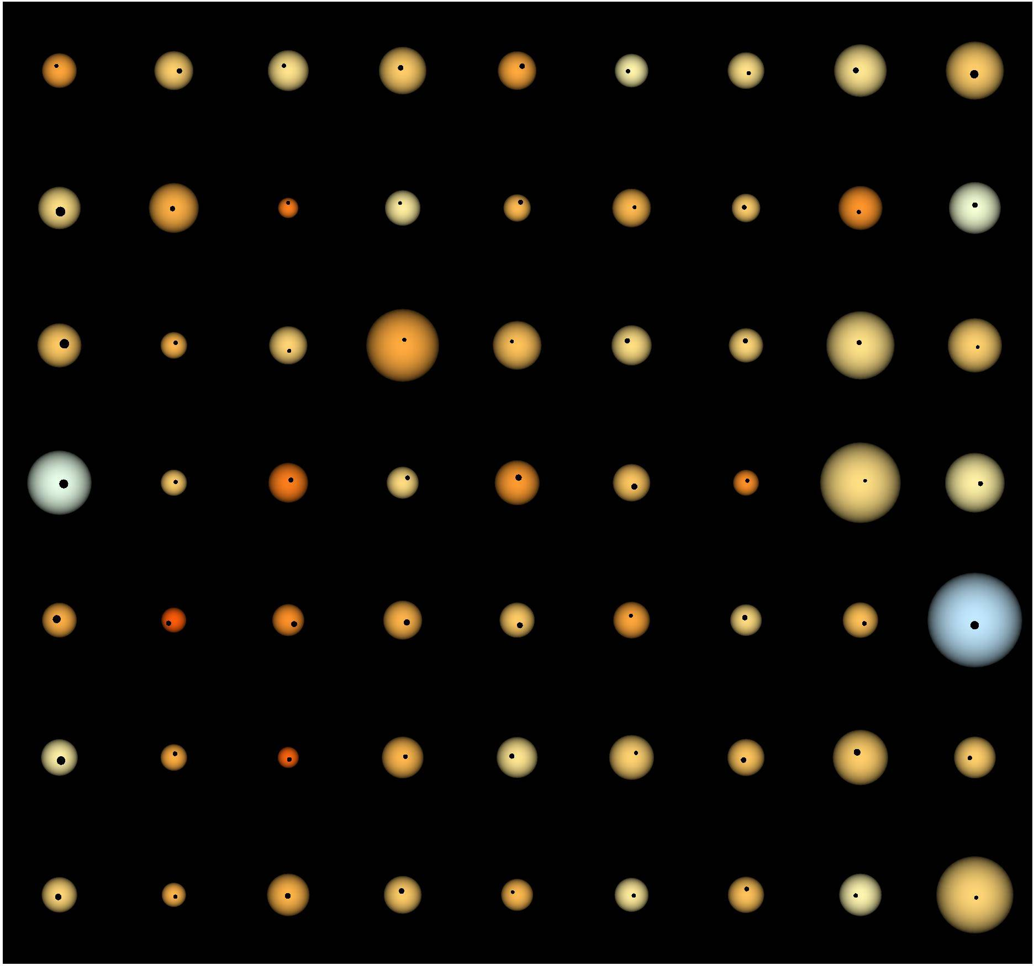
63 Hot Jupiter Systems

Slide 56
63 Hot Jupiter Systems
no nearby companion planets

Slide 57
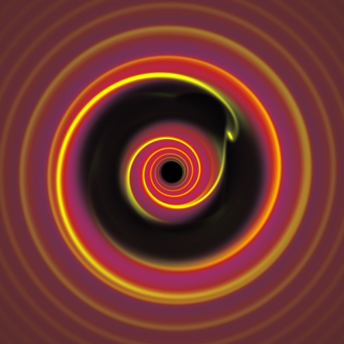
The movement of Planets
Peace and Harmony

Slide 58
The movement of Planets
Peace and Harmony
Violence and Mayhem

Slide 59
The movement of Planets
Peace and Harmony
Violence and Mayhem

Slide 60
The movement of Planets
Peace and Harmony
Violence and Mayhem
Small Planets
Large Planets

Slide 62
How lucky are we to live here?

Slide 64
Some anomalies from the solar system

Slide 65
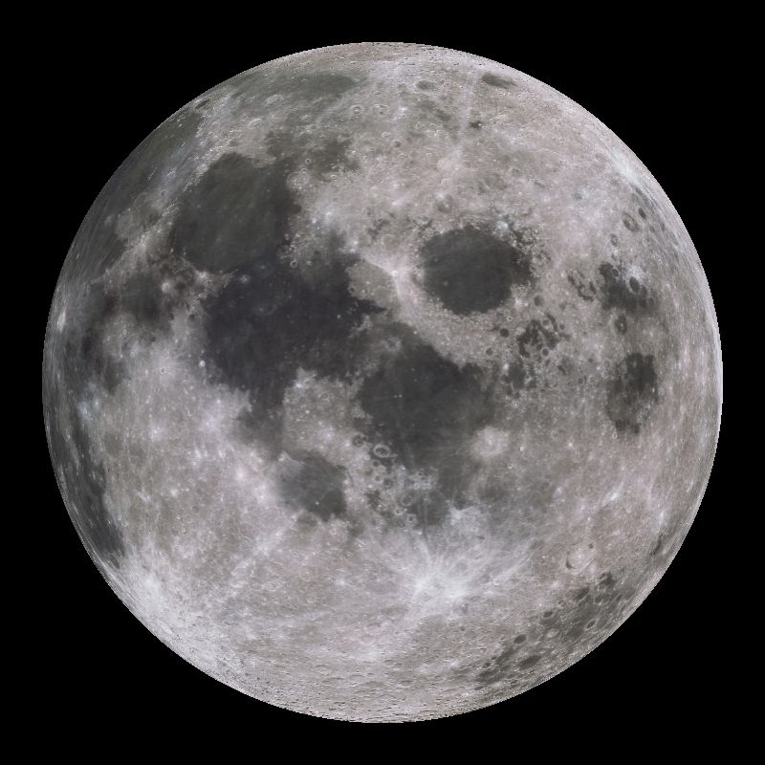
Some anomalies from the solar system

Slide 66
Some anomalies from the solar system
How did these
come about at
the time that
they did?

Slide 67
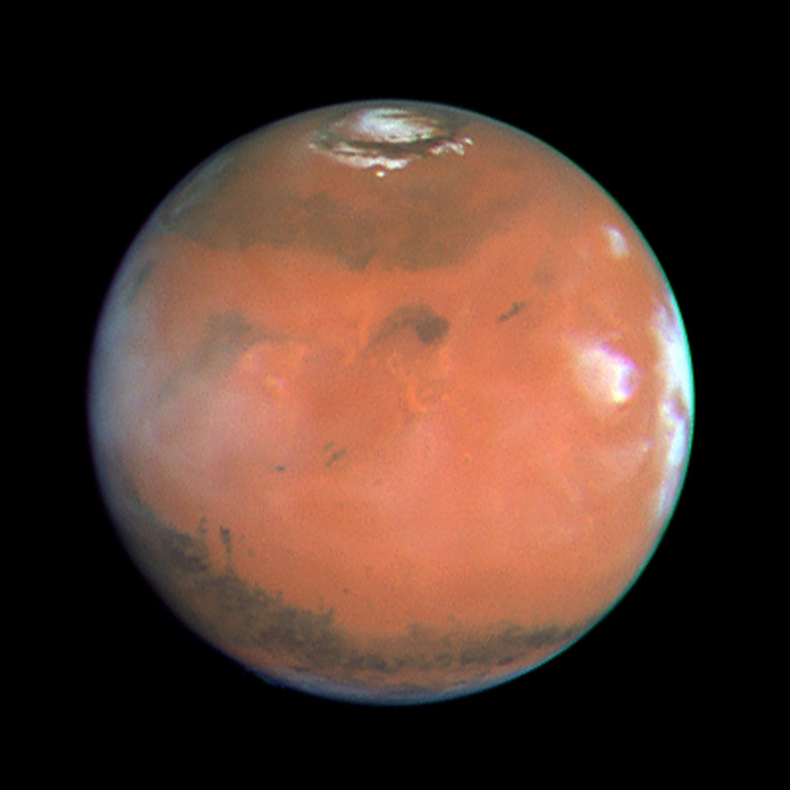
Some anomalies from the solar system

Slide 68
Some anomalies from the solar system
Why is Mars so small?
By rights it should be
Earth-sized.

Slide 69
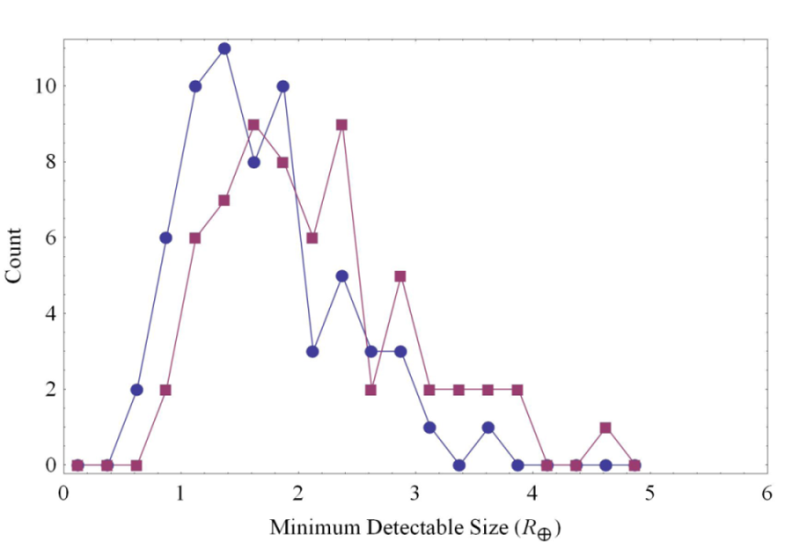
Hot Jupiter Systems
Look for transiting companions…

Slide 70
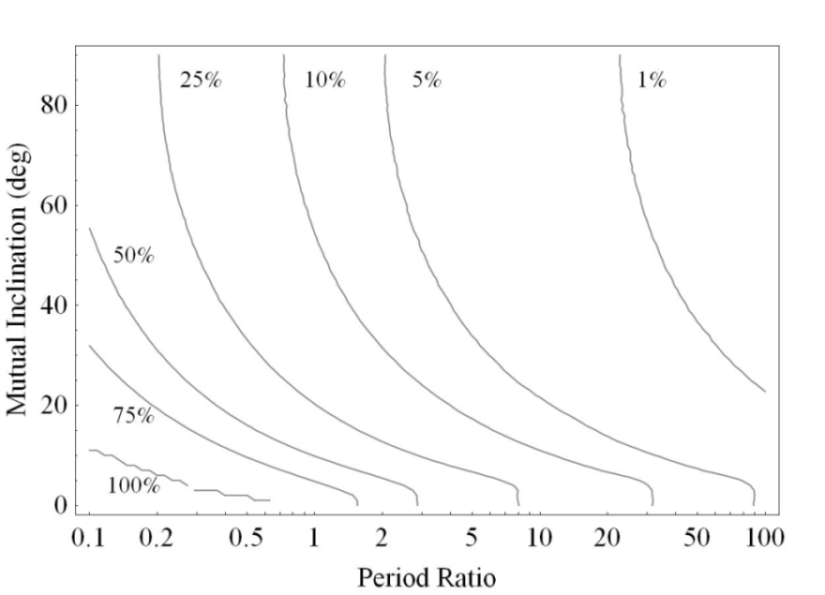
Hot Jupiter Systems
Look for transiting companions…
Consider mutual inclinations…

Slide 71
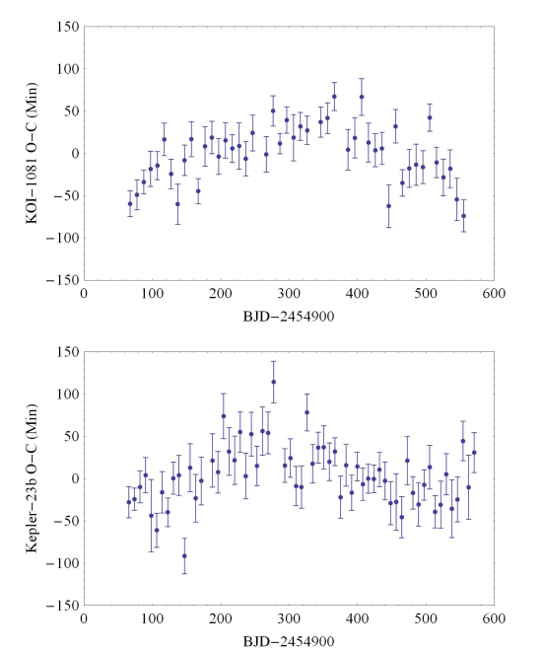
Hot Jupiter Systems
Look for transiting companions…
Look for TTVs in both
hot Jupiter and super Earth systems
Consider mutual inclinations…

Slide 72
Hot Jupiter Systems
  No known multiple planet systems
  No evidence for companions with TTVs
  No evidence for high inclination perturbers
  Yet there are known multiple systems in adjacent samples
  And observed TTV signals in adjacent samples

Slide 73
Hot Jupiter Systems
  No known multiple planet systems
  No evidence for companions with TTVs
  No evidence for high inclination perturbers
  Yet there are known multiple systems in adjacent samples
  And observed TTV signals in adjacent samples
  Hot Jupiters are lonely – Violence and Mayhem likely cause

Slide 74

How the other 99% lives

Slide 75


Architectures of Multiplanet Systems
Inclination and Multiplicity
Fang and Margot (2012)
Inclination and
Multiplicity
Lissauer et al (2011)
Period Ratios
Fabrycky et al.
(2012)
Size Ratios
Ciardi et al. (2013)

Slide 76

Candidate Radius Comparison
CDF of candidate radius ratio (outer/inner) – Saturn/Jupiter is 0.84, Earth/Venus is 1.05.

Slide 77
Inclination Distribution
Probability for Kepler to find the candidate population vs inclination and number of planets
Probability for Kepler to find the candidate population vs inclination and number of planets
Probability for Kepler to find the candidate population vs inclination and number of planets
(Solar system ~1.5 degrees)

Slide 78

Resonance Proximity
Slope of the CDF in period ratio averaged over four adjacent candidates.

Slide 79


Slide 80


Slide 81


Slide 82
Kepler Future
Kepler is moving into new regimes
  Longer periods
  Smaller candidates
  More transits
  Habitable Zones for larger stars
Important constraints on planet formation through
dynamical interactions and geometry
TTVs are proving an important component for
planet confirmation and characterization
Spacecraft able to operate for several more years
  Mission was extended earlier this year

